Slide 1
Semantic Plagiarism Detection and Idea Validation Using RAG-Based Embeddings Dharaniraj VM (2022115058) Jayasuriya R (2022115031) Sivasankaramoorthy R(2022115032)

Slide 2
01
Introduction

Slide 3
02
Problem Statement

Slide 4
Problem Statement
Validating the novelty of a thesis is a critical yet challenging task for academic institutions and PhD scholars. Universities and research committees often struggle to efficiently verify whether a submitted thesis presents a truly original contribution or if similar research already exists.
The current process of manually reviewing extensive academic literature is time-consuming and tedious, making it difficult to ensure academic integrity.
For PhD scholars, selecting a unique research problem is equally challenging. Existing plagiarism detection solutions primarily rely on keyword matching, which fails to capture semantic similarities between research topics, making them ineffective in identifying reworded or conceptually similar work.

Slide 5
03
Social Relevance

Slide 6
Social relevance:
ADDRESSING CHALLENGES IN ACADEMIC RESEARCH:
Validating the novelty of PhD theses is a complex and time-consuming task for universities. Our system automates this process using advanced embedding-based retrieval, ensuring a more accurate and efficient validation of thesis originality.
PREVENTING REDUNDANT RESEARCH
Many PhD scholars unknowingly choose topics that have already been explored, leading to wasted time and effort. By providing a semantic similarity check, our system helps researchers identify whether a similar study already exists. This ensures that scholars can either refine their ideas or choose a truly novel research problem, fostering meaningful academic contributions.

Slide 7
Social relevance:
IMPACT ON EDTECH AND INNOVATION:
The integration of AI-driven RAG (Retrieval-Augmented Generation) in EdTech revolutionizes how institutions handle research validation. By automating the thesis evaluation process, universities can accelerate approvals, improve research efficiency, and maintain a digital repository of ideas
SMARTER RESEARCH ECOSYSTEM:
By reducing redundant research, promoting ethical research practices, and ensuring genuine contributions, this system helps create a smarter, technology-driven research environment. Ultimately, it saves time, boosts innovation, and strengthens the global research community.

Slide 8
04
System Architecture

Slide 9
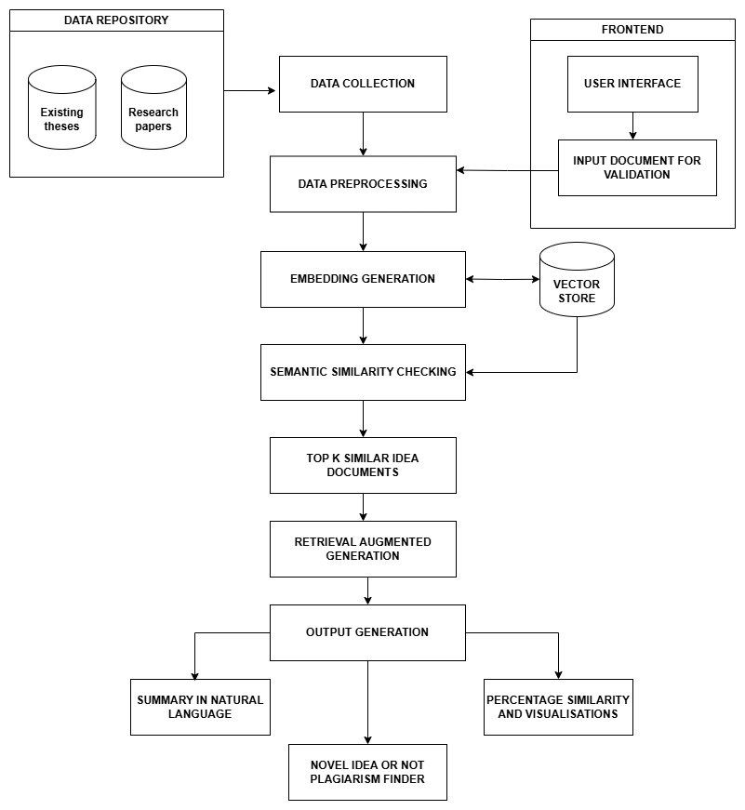

Slide 10
Detailed Design
05

Slide 11
06
Tools and technologies

Slide 12
Tools and technologies to be used
Data processing
Data extraction : PyMuPDF
Text processing : nltk and SpaCy
Hugging face tokenizer
RAG and Embedding similarity
Sentence Transformers from HuggingFace
FAISS vector store
Conversational retrieval chain from Langchain –RAG
Llama2 – LLM
Cosine similarity – ScikitLearn
Frontend and UI
React.js
Flask

Slide 13
06
Results and discussions

Slide 14
Conclusion
In this project we have successfully developed a customized model for Tamil language that integrates several advanced functionalities, showcasing significant achievements in Generative AI and Large Language Models. We were able to address the issue of code mixing in user queries.
Overall, this project demonstrates the effective application of cutting-edge NLP techniques to address specific linguistic needs, providing a robust tool for Tamil language users.
The integration of chat, document processing, OCR, and speech recognition establishes a versatile platform that can be further expanded for more complex applications in the future.

